Slide 1
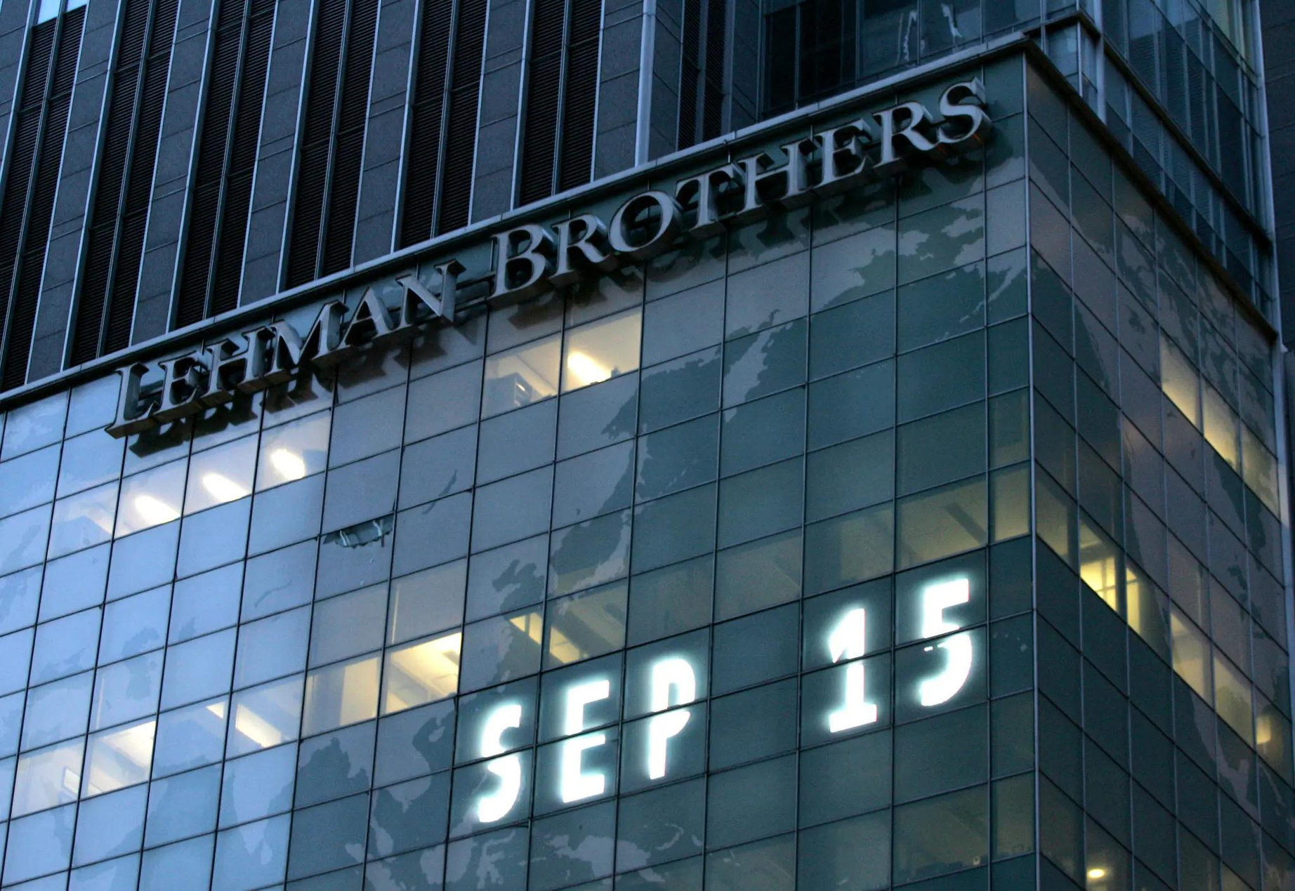


ADD COMPANY NAME
Lehman Brothers
Where Vision Gets Built
Founded: 1850
Bankruptcy: September 15, 2008
Information available in audio.

Slide 2






Business Model
Strategy involved calculated risk-taking to capitalize on investment opportunities
Investments in complex financial products left it vulnerable to market downturns
The high-risk, high-reward business model led to its downfall during the 2008 housing market crash.
Short-term profits and failure to address warning signs resulted in insufficient risk management.
Lehman Brothers

Slide 3
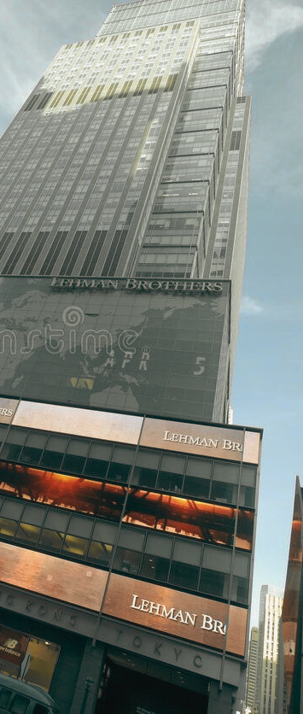
Factors causing Lehmans collapse
High leverage
Poor controls and risk management
High real estate concentration
Questionable accounting and poor disclosure
Weak government oversight
Back to Agenda
Lehman Brothers

Slide 4
Lessons Learnt from Lehman’s Collapsed
Over-reliance on Risk Models
Managing Risk
Develop
Self-defense Skill
Pay Attention to Any Flows in Banking Activities
Lehman Brothers

Slide 5
Bailout Debate
Argument for the bailout
Argument against the bailout
1.
Lehman Brothers had sufficient collateral
1.
Risky real estate investment
2.
Maintaining the integrity of the Federal Reserve
2.
Requested to become a bank holding company
3.
No buyer or merger partner could be found
3.
Bailout of other banks
4.
4.
Poor decision and careless risk taking
Devastation on the Main Street
5.
5.
Prioritizing the Interest of Taxpayers
Political interference
Lehman Brothers

Slide 6



Possible Alternatives to Bailout
Debt
Restructuring
Private Sector Intervention.
Regulatory
Intervention
Lehman Brothers

Slide 7





The 2008 financial crisis was a global economic crisis that resulted in significant losses for financial institutions and investors worldwide.
Key Lapses and Lessons Learned for Preventing Future Crises
Lax regulation and oversight by financial institutions.
Aggressive lending practices, particularly in the subprime mortgage market.
Deregulation of the financial industry, allowing for risky lending and investment methods.
Inadequate risk management policies in financial institutions.
Lehman Brothers' heavy investments in the subprime mortgage market.
Lehman Brothers

Slide 8

THANK YOU

